Slide 1


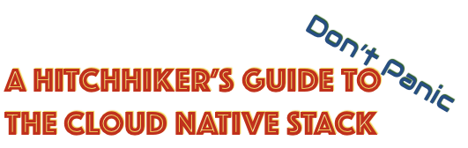
Microservices

Slide 2
(1) Microservice

Slide 3
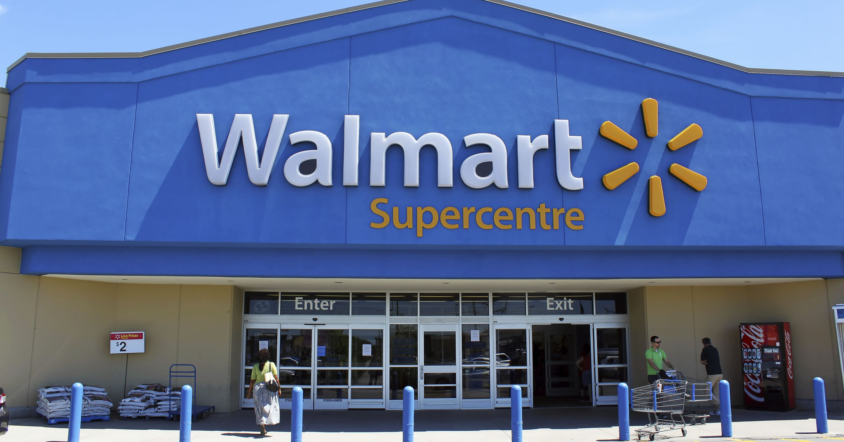

Slide 4

2002
Buying
Kaufprozess
Items

Slide 5
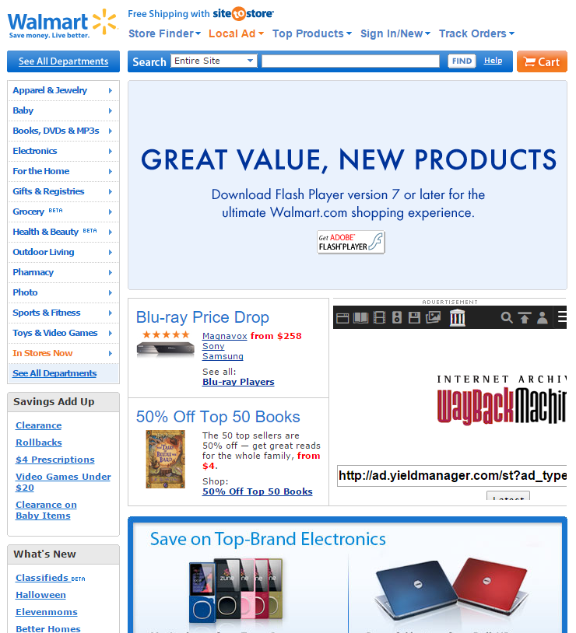
2008
Additional services

Slide 6
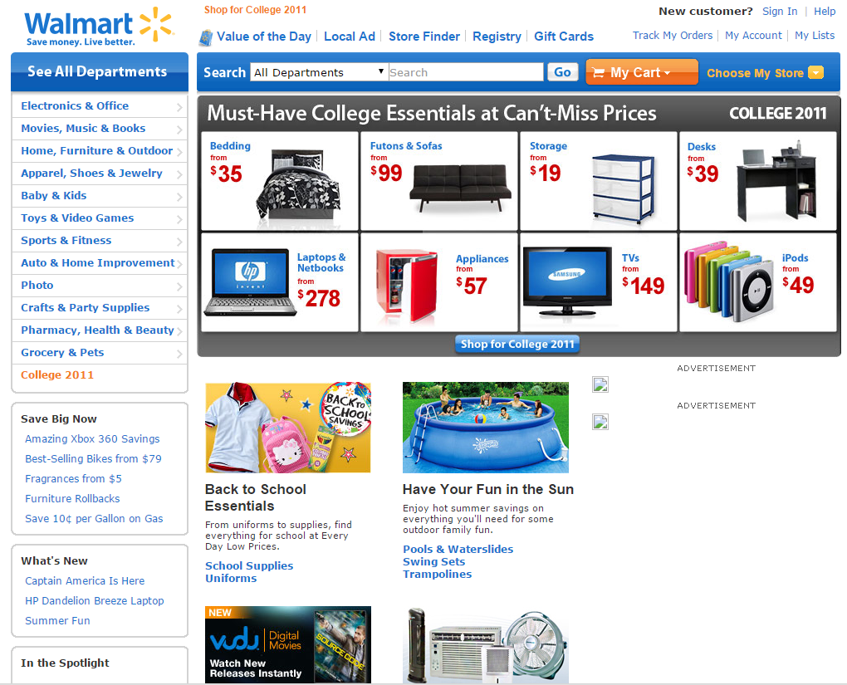
2011
Additional services (personalized)

Slide 7
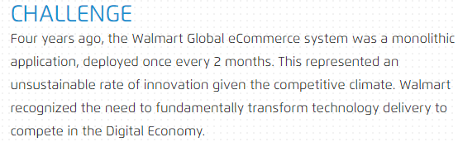
Long Change-to-Production
Walmart auf http://www.oneops.com
“[…] it was unable to scale for 6 million pageviews per minute and was down for most of the day during peak events.”
“This is the multi-million dollar question which the IT Department of Walmart Canada had to address after they were failing to provide to their users on Black Fridays for two years in a row.”
https://blog.risingstack.com/how-enterprises-benefit-from-microservices-architectures
Lacking scalability and elasticity

Slide 8
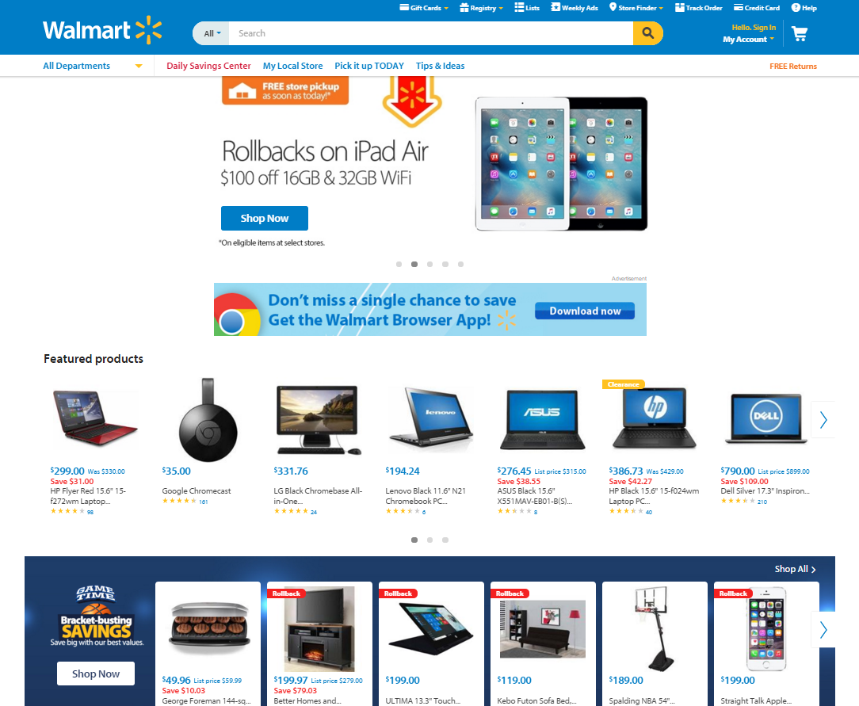
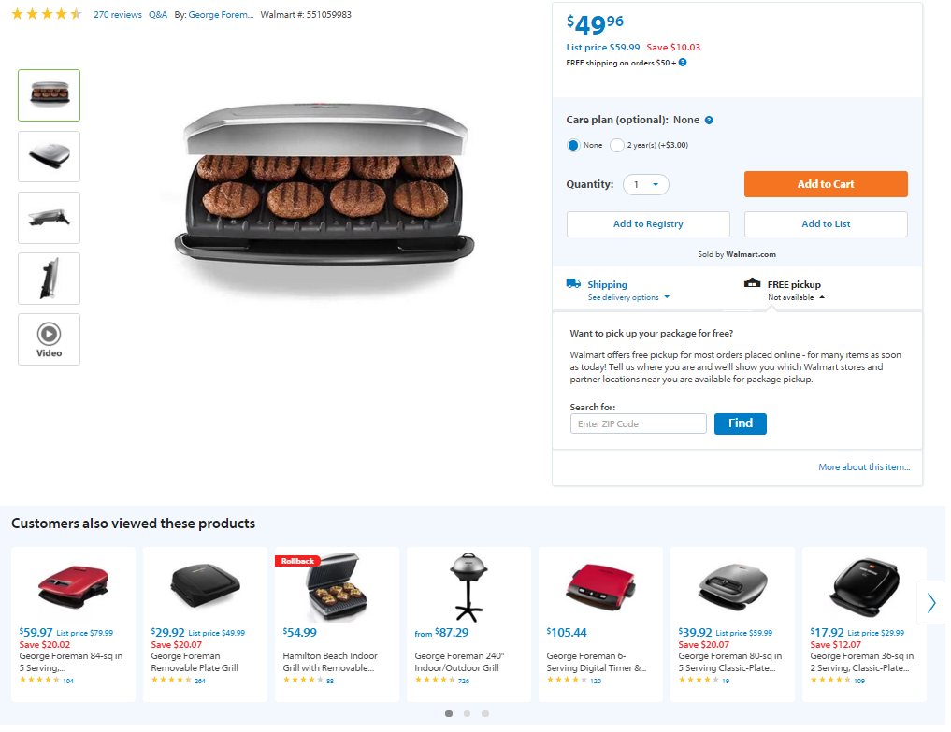
2016
Additional services
Zusätzliche Dienste (z.T. personalisiert)

Slide 9
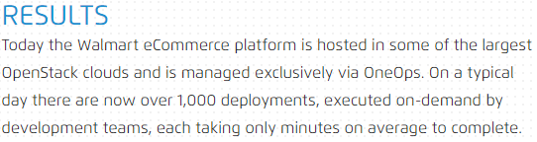
1,000 deployments a day
… triggered by dev teams
Walmart auf http://www.oneops.com
“They wanted to prepare for the world by 2020, with 4 billion people connected, 25+ million apps available, and 5.200 GB of data for each person on Earth.
Walmart replatformed […] with the intention of achieving close to 100% availability with reasonable costs.”
https://blog.risingstack.com/how-enterprises-benefit-from-microservices-architectures
~100% availability
“In fact, the organization reports that some 3,000 engineers […] drive 30,000 changes per month to Walmart software.”
“Those new applications, which span everything from mobile devices to the Internet of things (IoT), are crucial weapons in a global e-commerce contest that pits Walmart against the likes of Amazon and Alibaba, as well as a host of other rivals that are emerging as the cost of entry into the online retail sector continues to decline in the age of the API economy.”
http://www.baselinemag.com/enterprise-apps/walmart-embraces-microservices-to-get-more-agile.html
Enabled new kinds of applications (IoT, mobile, APIs) to compete globally
Resource efficiency
“The Walmart […] servers […] were able to handle all mobile Black Friday traffic with about 10 CPU cores and 28Gb RAM.”
“On Thanksgiving weekend, Walmart servers processed 1.5 billion requests per day. 70 percent of which were delivered through mobile.”
http://techcrunch.com/2014/12/02/walmart-com-reports-biggest-cyber-monday-in-history-mobile-traffic-at-70-over-the-holidays
Suitable scalability

Slide 10
What did they do?

Slide 11

The GAFA inspiration
Hyperscale resources (elastically scale-out) depending on traffic and data.
Hyperscale with success (pay-as-you-go). No opportunity costs with <10% ➔ 40-50% utilization and automate everything.
Hyperscale features (continuous delivery). Join the feature race with CD and DevOps: Develop, launch and operate a variety of features continuously.

Slide 12
Step 1: Decomposition

Slide 13
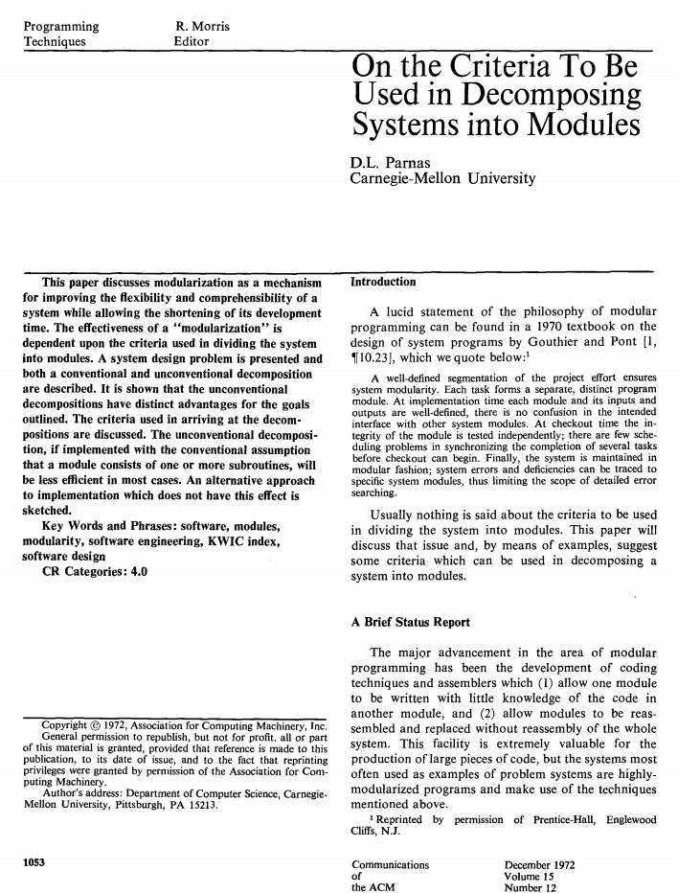

Slide 14
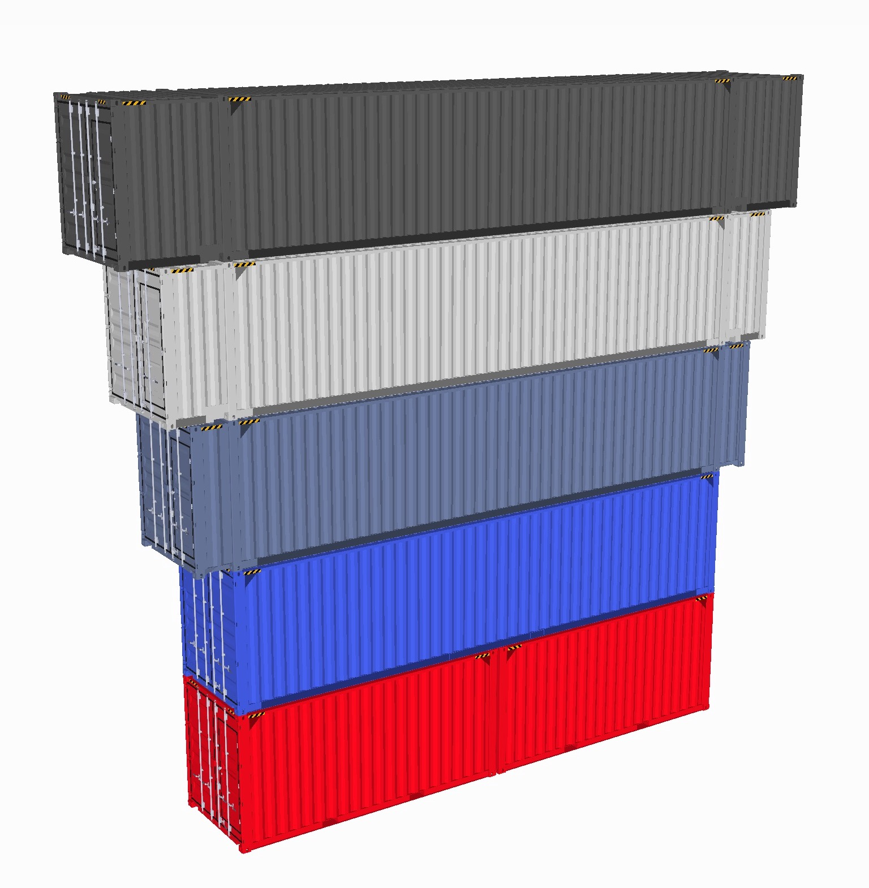
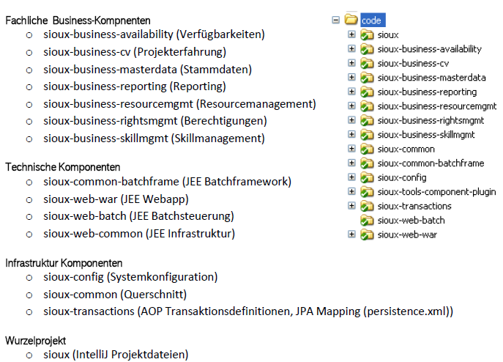
Cloud Native Applications Means: Components All Along the Software Lifecycle
DESIGN
BUILD
RUN
NEW!
Design Components
Dev Components
Ops Components
1:1
n:1
Complexity unit
Data integrity unit
Coherent and cohesive features unit
Decoupled unit
Planning unit
Team assignment unit
Knowledge unit
Development unit
Integration unit
Release unit
Deployment unit
Runtime unit (crash, slow-down, local access)
Scaling unit

Slide 15
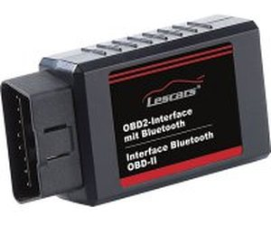

The Anatomy of an Ops Component
Internet Protocol
Container
Application
Diagnose Interface
Starting Inteface
Internet Protocol

Slide 16
The Anatomy of an Ops Component
Internet Protocol
Container
Application
Diagnose Interface
Starting Inteface
Internet Protocol
Contraints (mostly technology-driven):
Application does not use kernel space APIs (e.g. Oracle)
Application does not listen on random ports (e.g. RMI)
Application does not require an exotic operation system (e.g. z/OS)
Used endpoints (DNS name, Ips, Ports) can be configured

Slide 17
Dev Components
Ops Components
?:1
Good starting point
System
Monolith
Subsystems
Macroservices
Components
Microservices
Services
Nanoservices
+
Decomposition trade-off
-
More flexible to scale
Runtime isolation (crash, slow-down, …)
Independent releases, deployments, teams
Higher utilization possible
Distribution debt: Latency
Increasing infrastructure complexity
Increasing troubleshooting complexity
Increasing integration complexity

Slide 18
Ops Components with Spring Boot

Slide 19
Ops Components with Spring Boot
Mission statement: Bootable, Ops Friendly, Minimal
Docs: https://docs.spring.io/spring-boot/docs/current/reference/html
Key to success:
Spring Initializr: Choose the required building blocks. Tailor the runtime. Broad range of available building blocks.
Opinionated: Configuration by exception; convention over configuration.
Minimalistic API and set of annotations. No error-prone XML descriptors or bytecode manipulations.
Integrates common cloud infrastructure with the Spring Cloud project (http://projects.spring.io/spring-cloud)
Actuator: A full set of production readyness features.
DEV
OPS
Spring Boot
Spring Framework
Spring Cloud

Slide 20
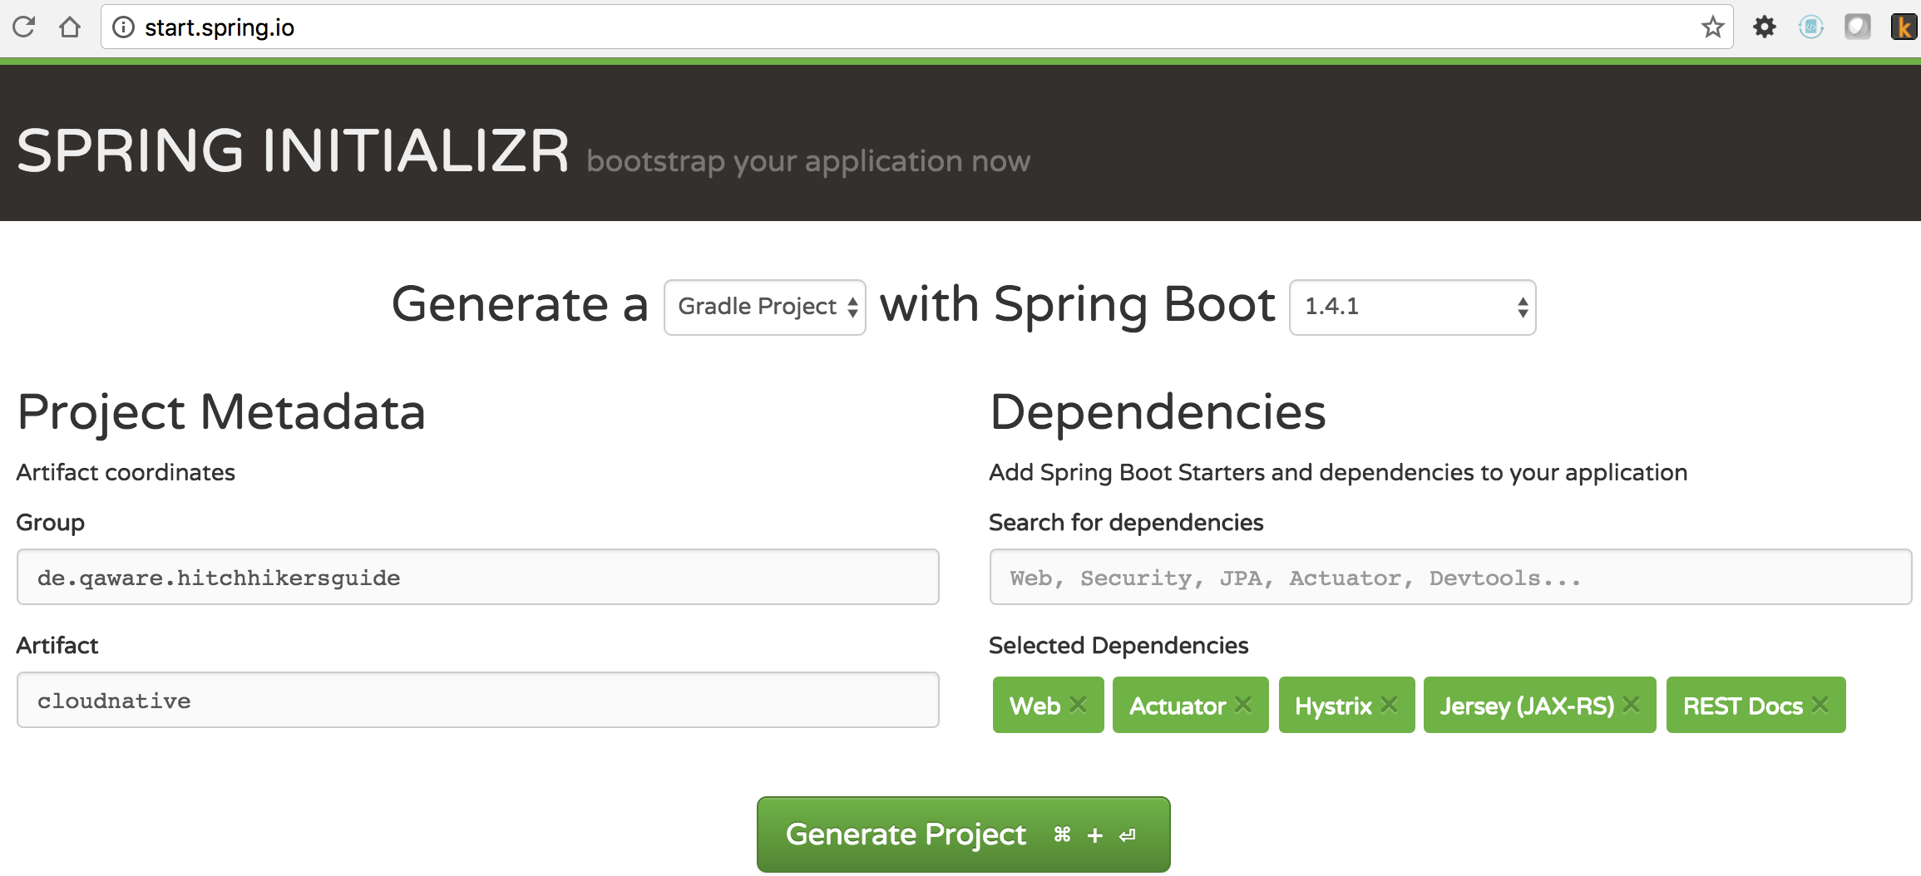
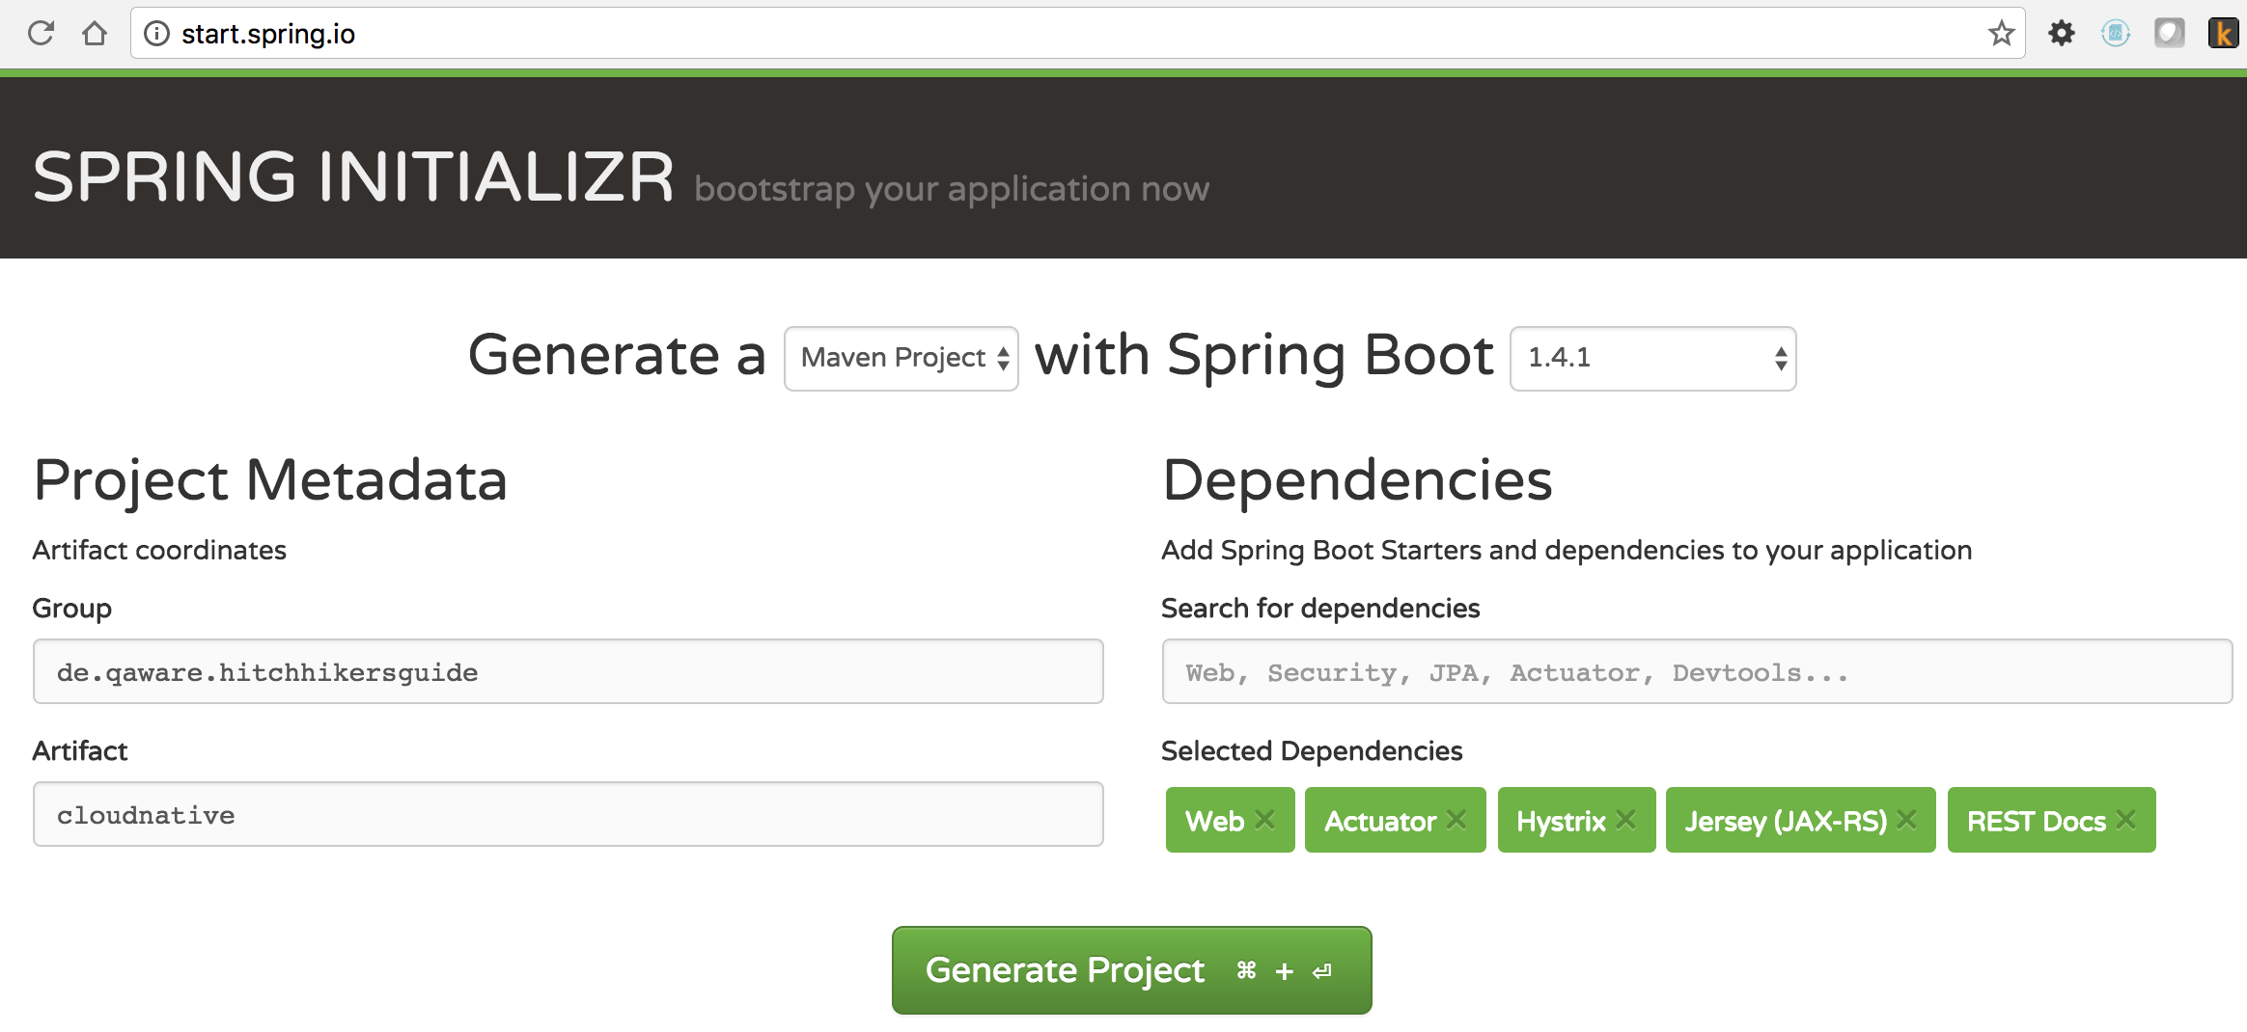
From the First He was the Initializr
http://start.spring.io/

Slide 21
Hello Spring Boot World!
@RestController
@EnableAutoConfiguration
public class Example {
@RequestMapping("/") String home() { return "Hello World!"; }
public static void main(String[] args) throws Exception { SpringApplication.run(Example.class, args);
}
}
REST API exposition
Auto configure magic. Wiring and configuring all dependencies.
$ ./gradlew bootRun

Slide 22
One more Thing: Circuit Breakers with Hystrix within Spring Boot

Slide 23
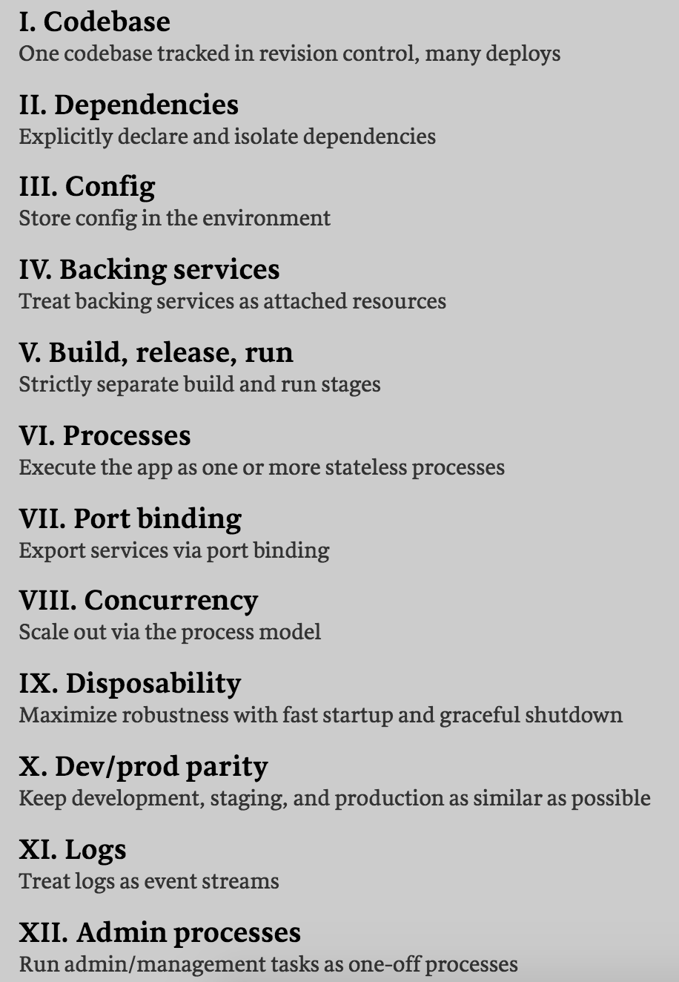
The Twelve-Factor App Principles

Slide 24
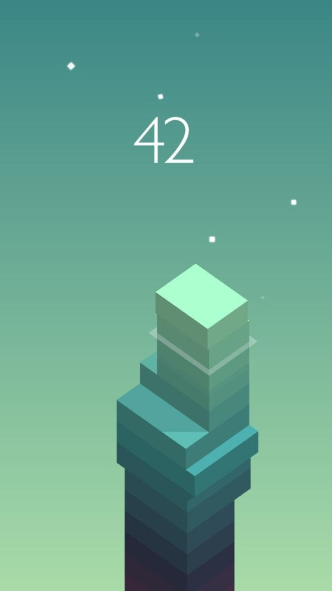
Step 2: Platformization
Good Decomposition
-
Distribution debt: Latency
Increasing infrastructure complexity
Increasing troubleshooting complexity
Increasing integration complexity
Cloud Native Stack!

Slide 25
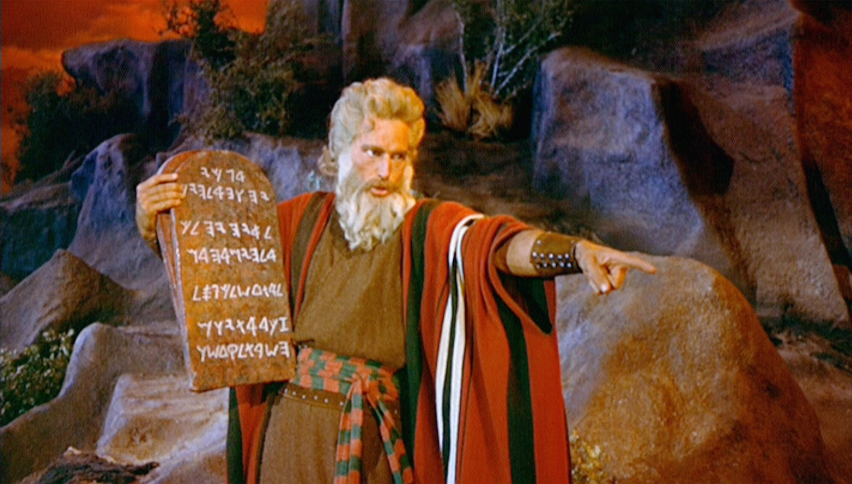
The 4 Cloud Commandments:
Everything Fails All The Time
Focus on MTTR not MTTF
Scale out not up
Treat resources as cattle not as pets

Slide 26
The Cloud Native Stack vs. Single Node Stack
Cloud Native Application
Classical Application
Cloud Native Application Platform
Application Server (e.g. Wildfly)
Cluster Operating System
Operating System (e.g. Linux)

Slide 27
The Cloud Native Stack
What infrastructure to provide for cloud native applications?
Cloud Native Application Platform
Classical Applications
Cloud Native App
Cluster Operating System
How to run (containerized) applications on a cluster? How to automate standard operations procedures?
Cluster Orchestrator
Applications
How to provide the right resources for container execution? (e.g. for high utilization)
Cluster Scheduler
Container
Cluster Virtualization
Resources
How to decouple from physical hardware?

Slide 28
Step 3: Establish Continuous Delivery

Slide 29
Continuous Delivery
Process
Dev
Ops
CI
Containerize
Orchestrate
Code
Package
Package
App
Organization
Infrastructure
Cluster Operating System

Slide 30
Image Credits
José Sarrablo
Tarun Kumar Sukhu
https://springframework.guru
picture alliance / United Archiv
Niloo138, Getty Images)

